Slide 1


What’s the Score?
Eternal Vigilance Required
Presented By
Joe Wolverton, II, J.D., JBS Constitutional Law Scholar

Slide 2
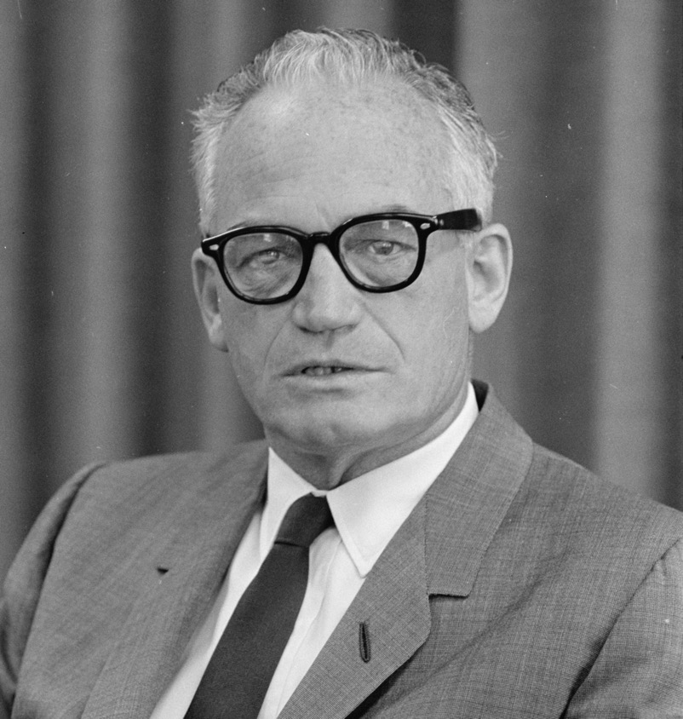
“If we hold a constitutional convention, every group in the country — majority, minority, middle-of-the-road, left, right, up, down — is going to get its two bits in and we are going to wind up with a constitution that will be so far different from the one we have lived under for 200 years that I doubt that the Republic could continue.”
— Senator Barry Goldwater, February 26, 1979
Notes:
Quote: “If we hold a constitutional convention...I doubt that the Republic could continue.” — Senator Barry Goldwater, 1979
Objective: Understand the complexities and potential dangers of an Article V Convention.

Slide 3
Contents of This Presentation
 | WHAT IS ARTICLE V?
 | WHY AN ARTICLE V CONVENTION IS A BAD IDEA
 | HOW CLOSE HAVE WE COME TO HAVING A CONVENTION, AND WHERE DOES THE BATTLE STAND TODAY?
 | THE LATEST TOOLS YOU CAN USE TO PROTECT THE U.S. CONSTITUTION AND BILL OF RIGHTS
 | CONCLUSION

Slide 4
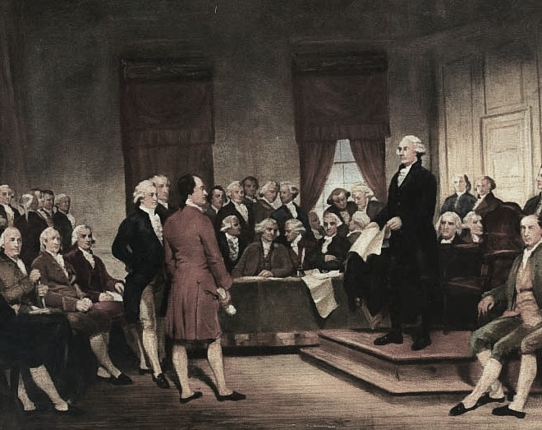
01
What Is Article V?

Slide 5
What Is Article V?
Definition:
Article V of the U.S. Constitution provides two methods for amending the Constitution.
Methods:
  Congress proposes amendments.
  A convention is called by two-thirds of state legislatures.

Slide 6

Just as wedding vows aren’t to blame for cheating spouses, the Constitution isn’t to blame for corrupt politicians. Changing the former would have no effect on the latter.
Notes:
The Argument Against an Article V Convention
Main Point: The Constitution is not the problem; enforcement and adherence are.
Analogy: Wedding vows and infidelity vs. constitutional adherence.

Slide 7
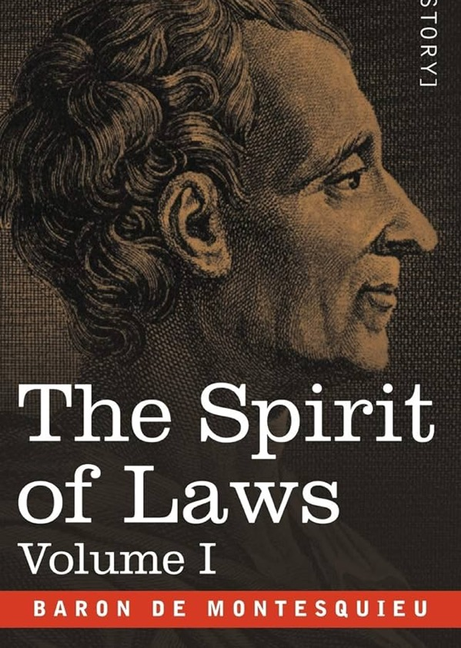
“Constant experience shows us that every man given power is likely to abuse it, and to carry his authority as far as he can go until he comes up against limits.”
— The Spirit of Laws by Montesquieu
Notes:
Quote: “Every man given power is likely to abuse it.” — Montesquieu
Founders' Preparation: Framers understood the potential for abuse and the necessity of virtue in governance.

Slide 8
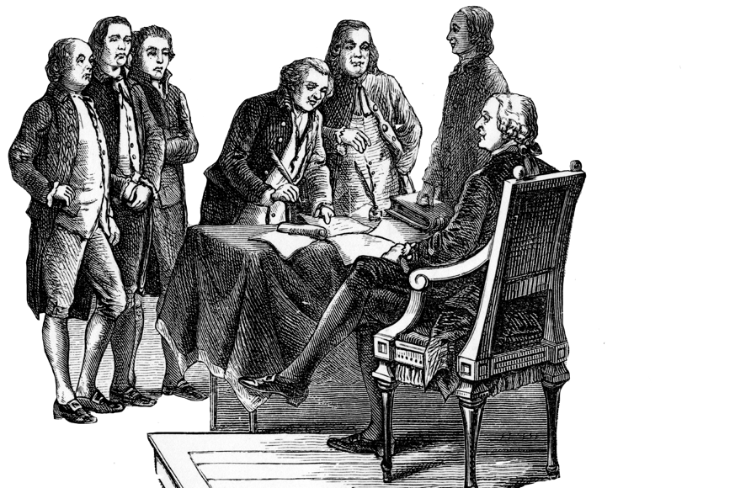
Founders’ Preparation:
Framers understood the potential for abuse and the necessity of virtue in governance

Slide 9
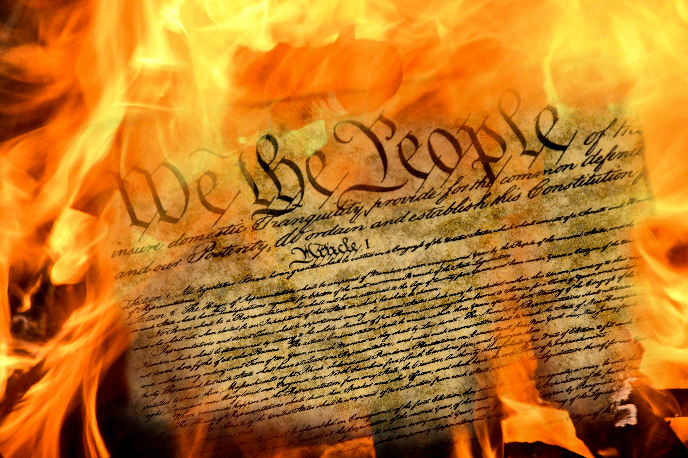
02
WHY
An Article V Convention
Is a Bad Idea

Slide 10
Key Concerns With an Article V Convention
No constitutional authority for a limited convention
Unanswered questions and ambiguities:

Slide 11
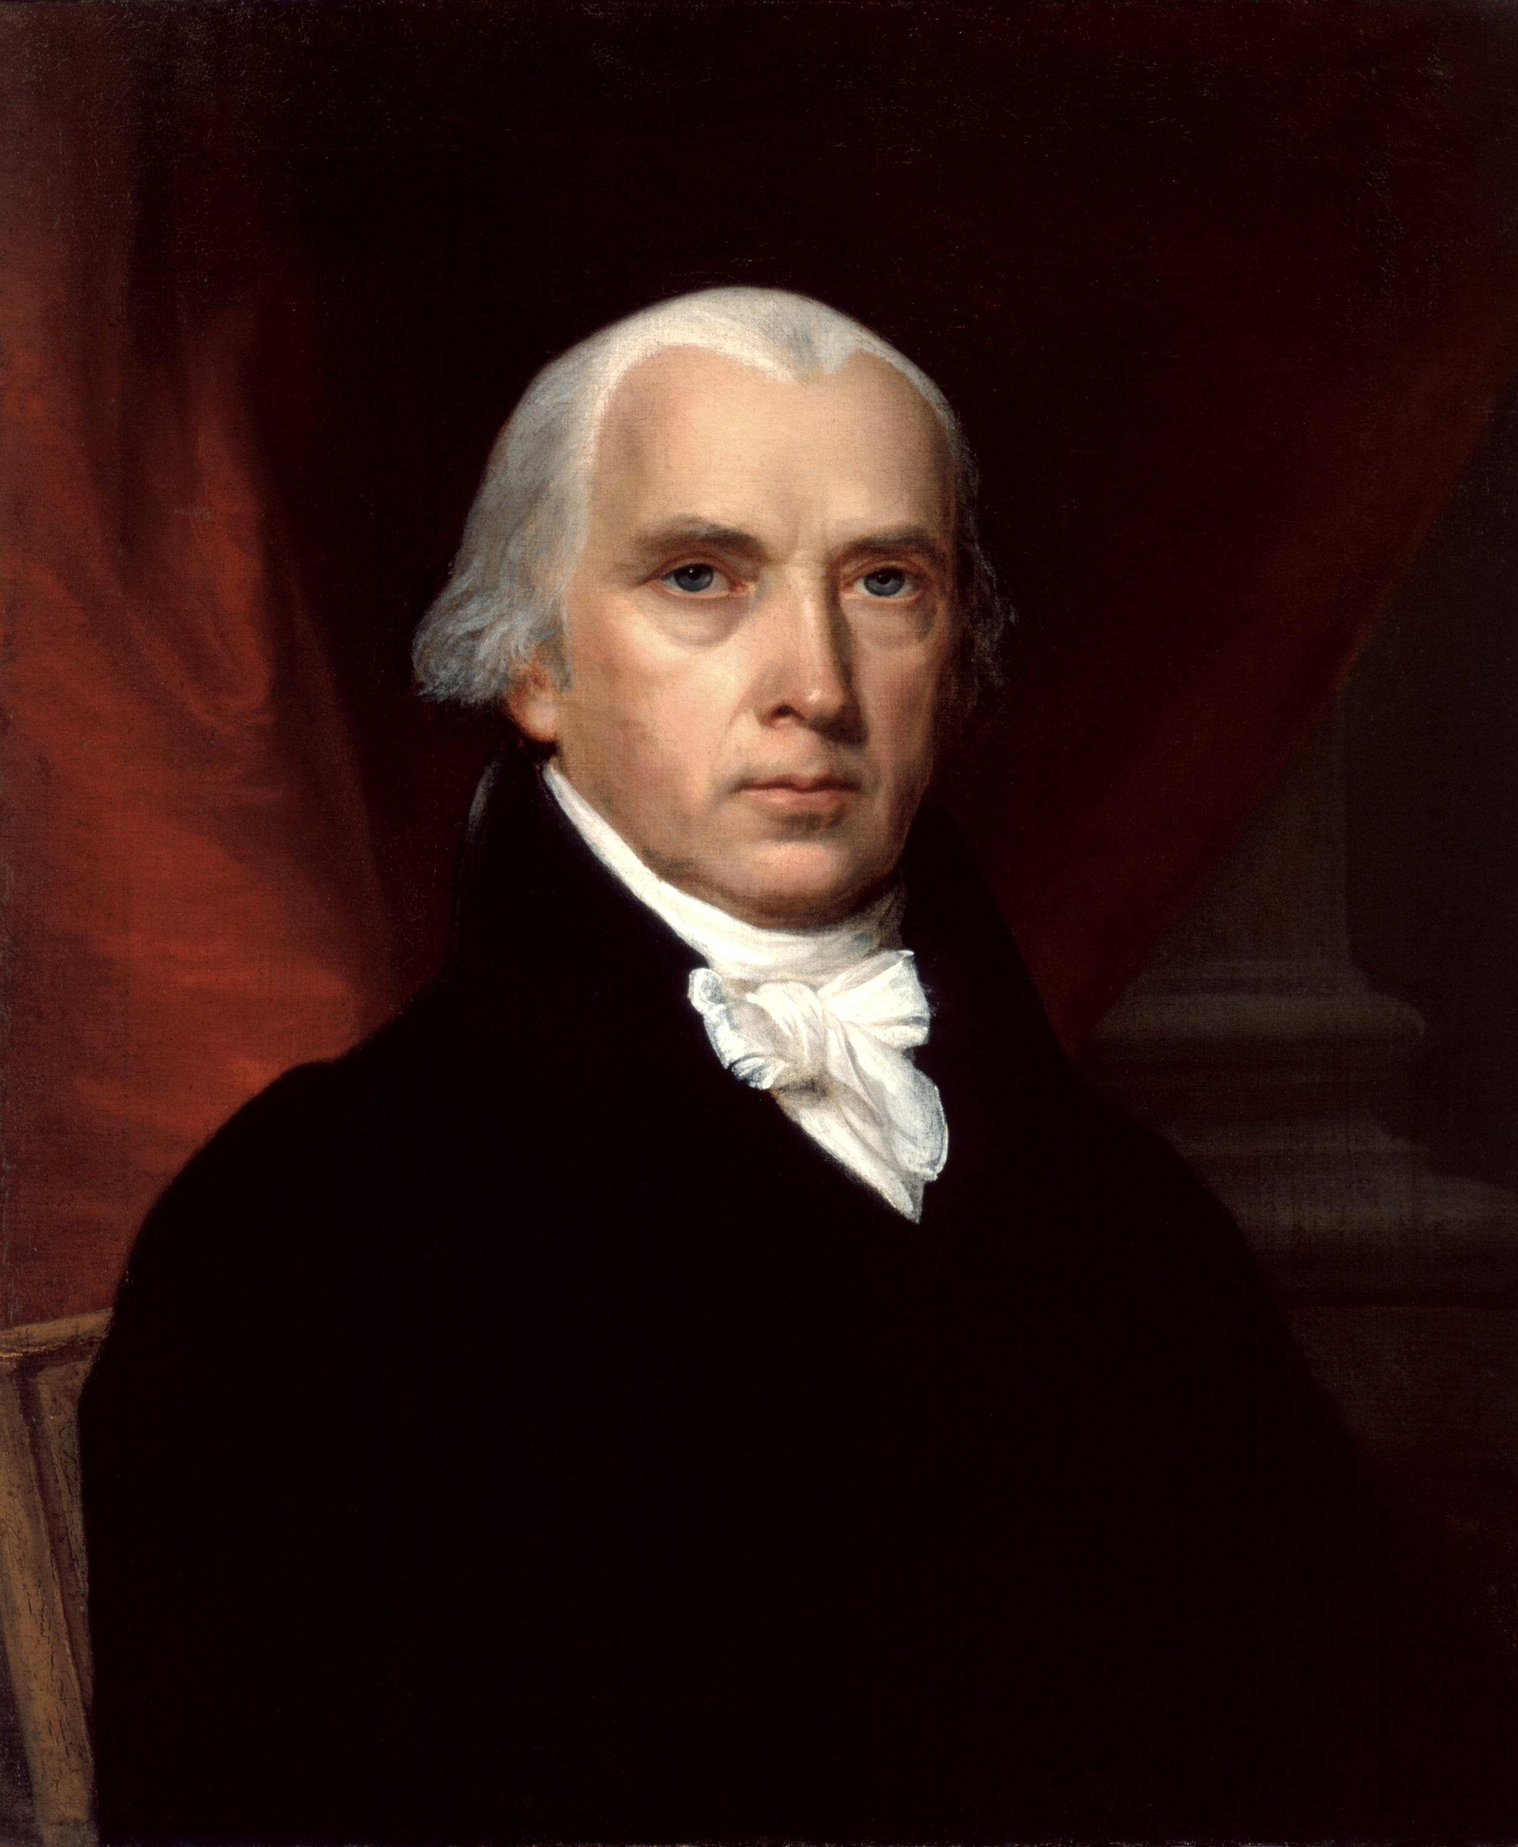
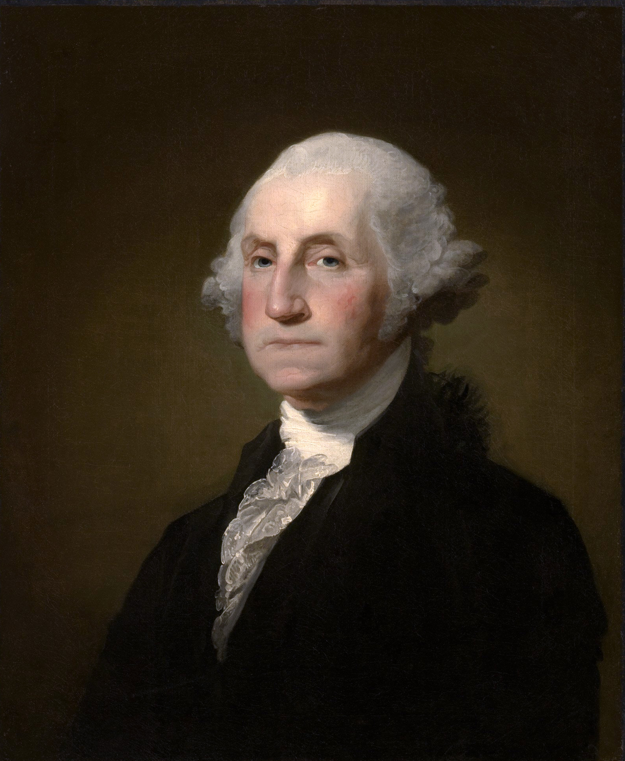
1776
NOW
?
?
Notes:
State Rescission Rights
Republican Government: States should have the power to rescind applications for a convention.
Representation Principle: New legislatures should reflect current public opinion.
“Representation is a core aspect of republican government.”

Slide 12
CRITICAL QUESTIONS LEFT UNANSWERED
Who would select the delegates?
How would rules be established and enforced?
Will the process be subject to oversight by the U.S. Supreme Court?
How would votes be taken in such a convention? By population? By state? By delegate?

Slide 13


IRREFUTABLE FACTS ABOUT
AN ARTICLE V CONVENTION
No way to limit the convention’s scope
No role for the people once the convention starts
Risk of a runaway convention
Notes:
20 Irrefutable Facts About an Article V Convention
Examples:
No way to limit the convention’s scope.
No role for the people once the convention starts.
Risk of a runaway convention.
“There is no constitutional authority for a limited convention.”

Slide 14
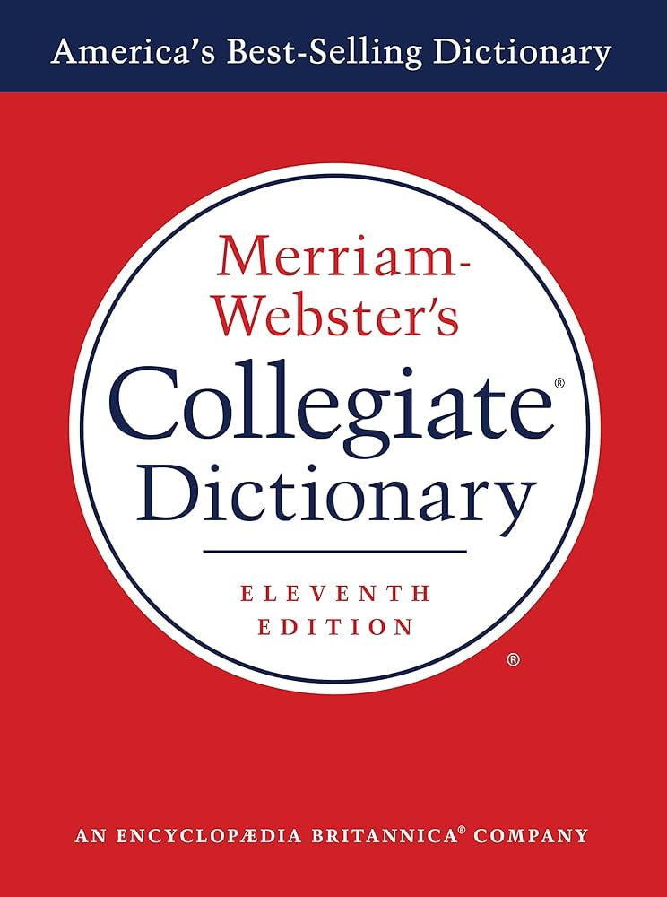
pon·der
/ˈpändər/
Transitive verb
1: to weigh in the mind : APPRAISE
2: to think about : reflect on
— Merriam-Webster Dictionary
Notes:
Quote: “Every man given power is likely to abuse it.” — Montesquieu
Founders' Preparation: Framers understood the potential for abuse and the necessity of virtue in governance.

Slide 15
IRREFUTABLE FACTS ABOUT
AN ARTICLE V CONVENTION
No rules governing the ratification conventions Congress could choose to call
No power for the people to stop a convention once it starts
No description of the ratification conventions Congress could choose to call
No means provided for the people or the states to challenge Congress’ method of ratification
No test provided for a qualifying application submitted by a state
No provision for how rules would be established or enforced

Slide 16
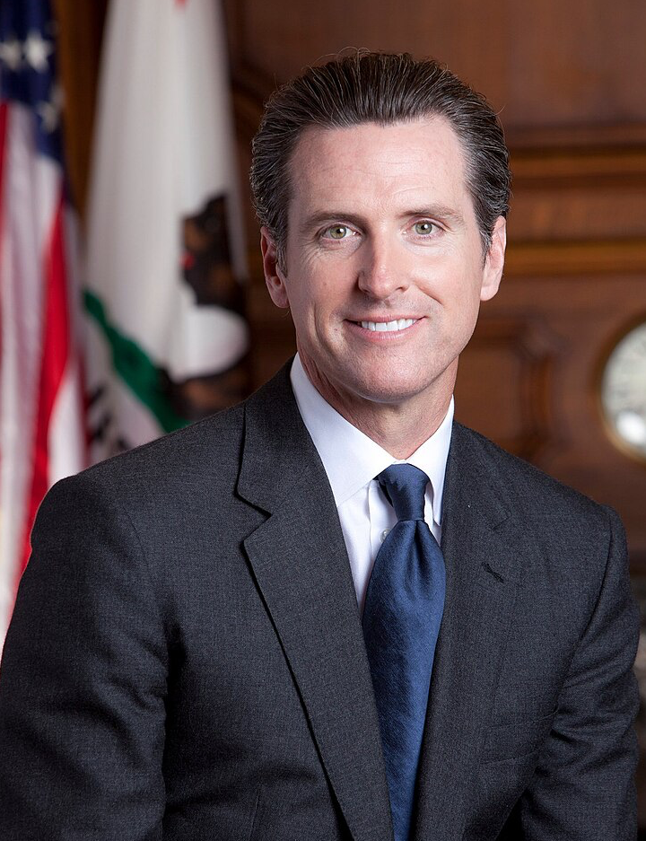
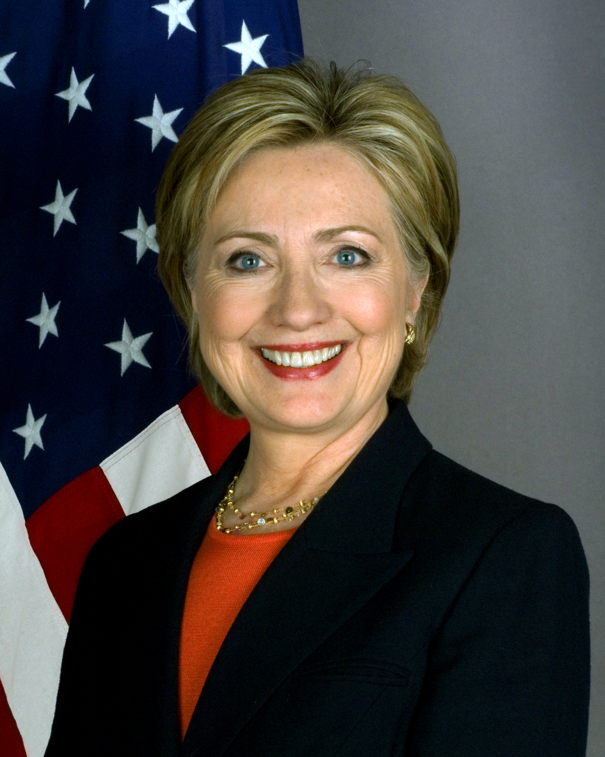
POTENTIAL DELEGATES?
Notes:
State Rescission Rights
Republican Government: States should have the power to rescind applications for a convention.
Representation Principle: New legislatures should reflect current public opinion.
“Representation is a core aspect of republican government.”

Slide 17
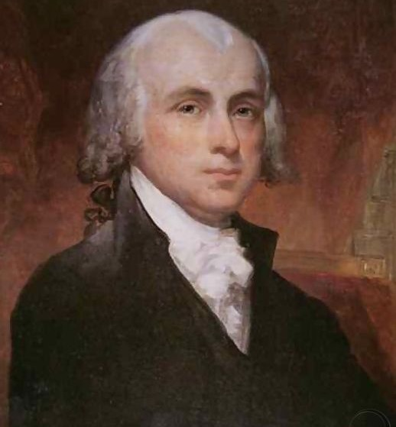
In The Federalist No. 40
Madison explained that the delgates knew they were exceeding their authority
Notes:
Madison’s Plan in The Federalist No. 46
Key Strategies:
Public unease and non-cooperation.
Governors and state legislatures standing up to federal power.
Unified state action against federal overreach.
“People’s strong resistance and unwillingness to comply can effectively challenge and oppose federal overreach.”

Slide 18
People aren’t paying attention to the Constitution
THE MAIN PROBLEM

Slide 19
Risks of a
Runaway Convention
HISTORICAL EXAMPLE: The 1787 Convention exceeded its mandate.
MODERN RISKS: Delegates like Gavin Newsom or Hillary Clinton could push agendas far from original intent.
  “Historical evidence, such as The Federalist No. 40, debunks claims that a runaway convention is unfounded.”

Slide 20
Limited Conventions
Are Unconstitutional
No Historical Precedent
Potential for Partisan Agendas
Risk of Constitutional Crisis
  “The only precedent for a constitutional convention is the 1787 Convention.”

Slide 21
States’ Rescission Rights
Republican
Government
Representation
Principle
Notes:
State Rescission Rights
Republican Government: States should have the power to rescind applications for a convention.
Representation Principle: New legislatures should reflect current public opinion.
“Representation is a core aspect of republican government.”

Slide 22
Delegate Selection Concerns
Simulation Concerns:
Bias in delegate selection
Real-world Risks:
Unpredictable changes and representation issues
Notes:
Delegate Selection Concerns
Simulation Concerns: Bias in delegate selection.
Real-world Risks: Unpredictable changes and representation issues.
“A simulated convention in 2023 showed bias in delegate selection.”

Slide 23

Balanced Budget
& Term Limits
  Balanced budget: Unnecessary and likely unheeded
  Term limits: Unconstitutional and potentially harmful
Notes:
Balanced Budget and Term Limits
Balanced Budget: Unnecessary and likely unheeded.
Term Limits: Unconstitutional and potentially harmful.
“The federal government lacks constitutional authority for its current spending and tax-collection practices.”

Slide 24
03
How Close Have We Come,
And Where Does the Battle Stand Today?

Slide 25
Organizations Putting Us at Risk
Article V Convention
Convention of States
Balanced Budget Amendment (BBA)
Wolf-PAC

Slide 26
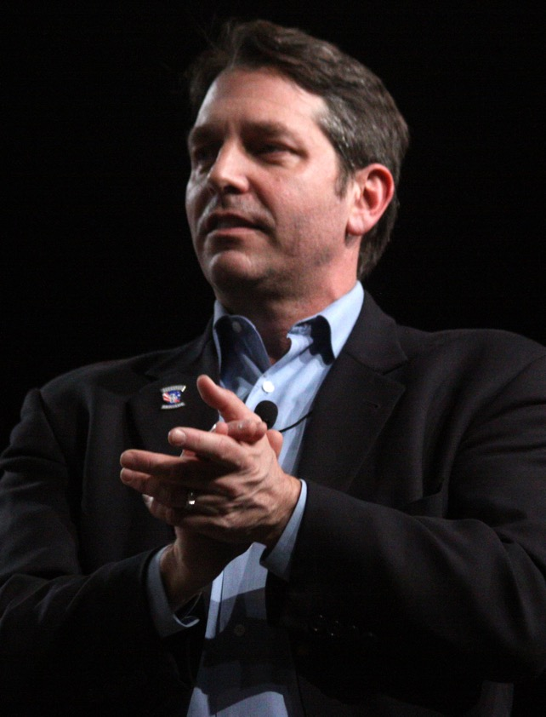

Convention of States
Also known as COS Action/COS Project,
co-founded by COS President Mark Meckler.
Some states have fully passed and transmitted applications to Congress for the specific purpose of calling a convention for proposing amendments that ostensibly would:
Impose fiscal restraints on the federal government,
Limit its power and jurisdiction, and
Impose term limits on its officials and members of Congress.

Slide 27
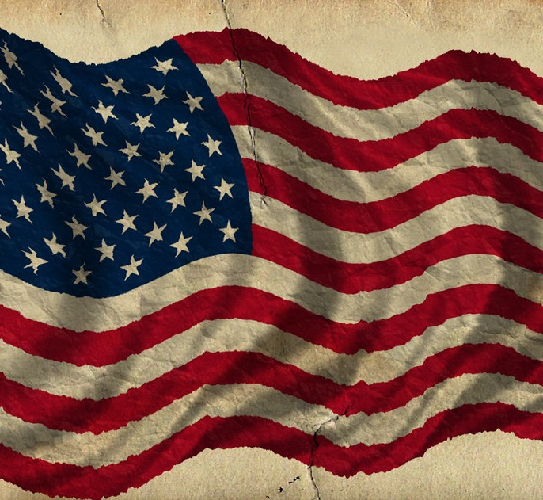

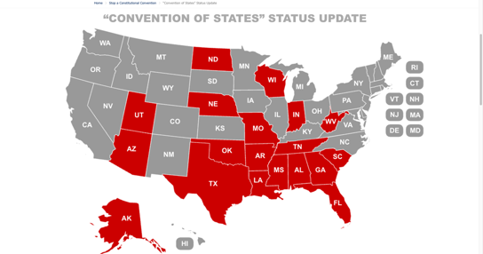
Convention of States
jbs.org/concon/convention-of-states/
See where your state currently stands.

Slide 28

Balanced Budget Amendment (BBA)
The legislatures of more than half of the states have fully passed and transmitted applications to Congress for the specific purpose of calling a convention to propose a federal Balanced Budget Amendment (BBA) to the U.S. Constitution.

Slide 29
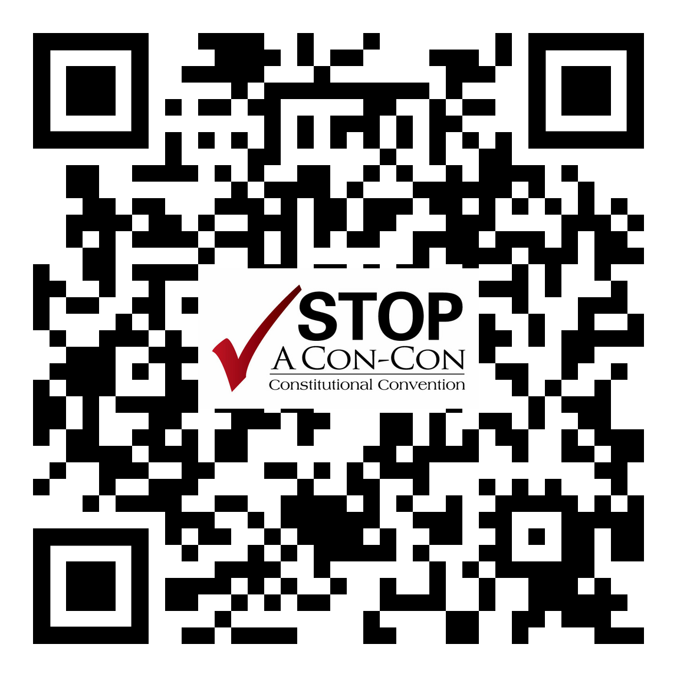
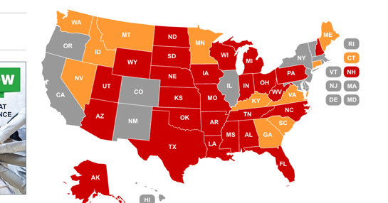
Balanced Budget Amendment (BBA)
jbs.org/concon/status-update/
See where your state currently stands.

Slide 30

Wolf-PAC
Wolf-PAC seeks the passage of a vague constitutional amendment to ostensibly get money out of politics and end federal and state corruption.
Infringes on First Amendment freedoms of speech and expression by limiting the ability of individuals to contribute to their preferred political organizations.
Seeks to change how the U.S. form of government is described in the Constitution.

Slide 31
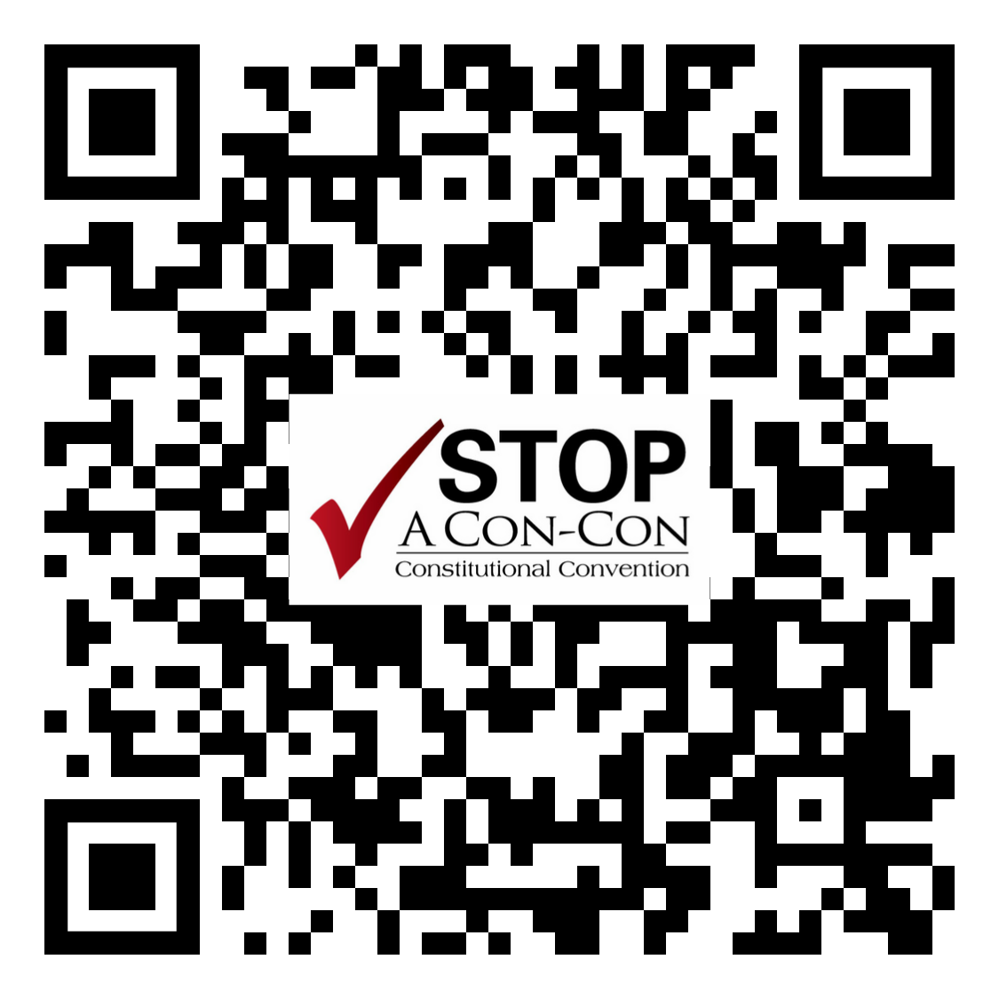
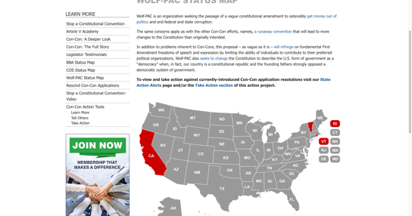
Wolf-PAC
jbs.org/concon/wolf-pac-status-update/
See where your state currently stands.

Slide 32
04
THE LATEST TOOLS
You Can Use to Protect the U.S. Constitution and Bill of Rights

Slide 33

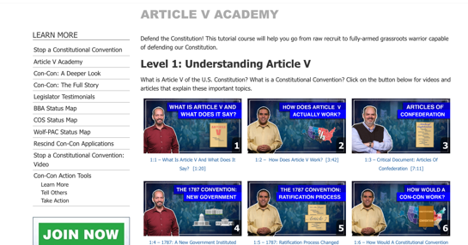
Article V Academy
jbs.org/concon/academy/
Defend the Constitution! This tutorial course will help you go from raw recruit to fully-armed grassroots warrior capable of defending our Constitution.

Slide 34

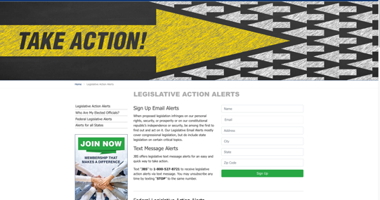
Sign Up for Action Alerts
jbs.org/alerts/
Stay on top of legislation effortlessly. Sign up for instant alerts on your phone or via email.

Slide 35




Article V Academy

Slide 36
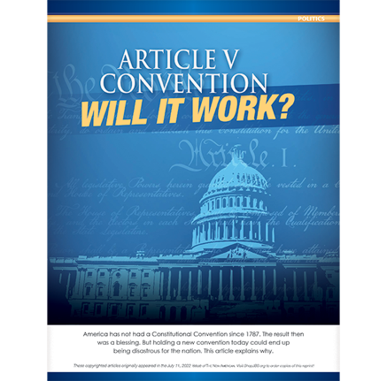
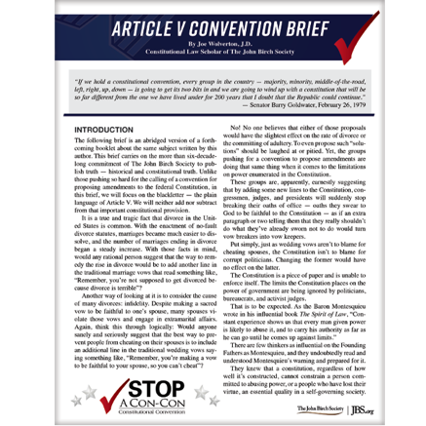
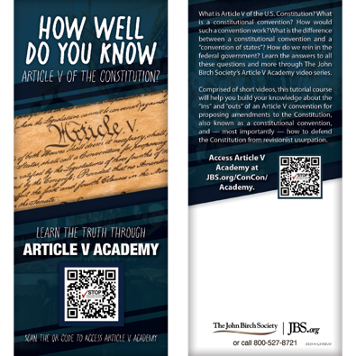
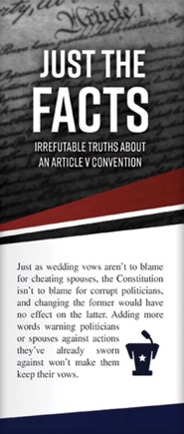
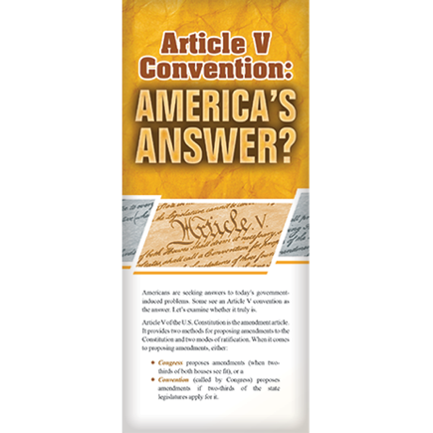
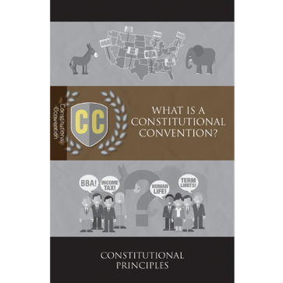
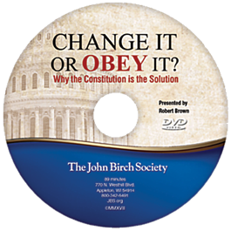
ShopJBS Products
ShopJBS.org/products/jbs/action-projects/stop-a-con-con/

Slide 37
05
Conclusion

Slide 38
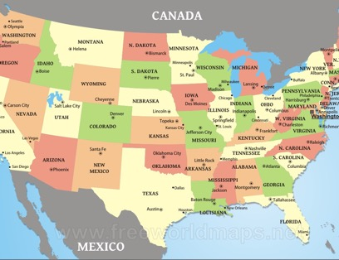

Nullification Is the Rightful Remedy
Tenth Amendment:
Contract Law:
States’ power to check federal overreach.
Federal government is an agent of the states.
Notes:
Nullification as the Rightful Remedy
Tenth Amendment: States’ power to check federal overreach.
Contract Law: Federal government as an agent of the states.
“The Tenth Amendment already provides the means to restrain the federal government.”

Slide 39
Madison’s Plan in The Federalist No. 46
Notes:
Madison’s Plan in The Federalist No. 46
Key Strategies:
Public unease and non-cooperation.
Governors and state legislatures standing up to federal power.
Unified state action against federal overreach.
“People’s strong resistance and unwillingness to comply can effectively challenge and oppose federal overreach.”

Slide 40
Constitutional Weapons to Fight Tyranny
How to Use Those Weapons
People’s unease as a catalyst
Public resentment against overreach
Active non-cooperation
Governors standing up to federal power
State legislative strategies
Forming a united front
Strategic resistance plans
Unified action across states
Widespread alerts for federal overreach
United front among states
Opening lines of communication
Coordinating a resistance plan
Unified spirit and action
States banding together as against a foreign threat
Potential for a showdown

Slide 41
  We can force the federal beast back inside its constitutional cage by reading Article V.
Notes:
Conclusion
Summary of Key Points:
The risks of an Article V Convention outweigh the potential benefits.
Effective remedies already exist within the Constitution.
“Forcing the federal beast back inside its constitutional cage.”

Slide 42
Conclusion
  The risks of an Article V Convention outweigh the potential benefits.
  Effective remedies already exist in the Constitution.
  “Forcing the federal beast back inside its constitutional cage.”
      — Article V Convention Brief
Notes:
Conclusion
Summary of Key Points:
The risks of an Article V Convention outweigh the potential benefits.
Effective remedies already exist within the Constitution.
“Forcing the federal beast back inside its constitutional cage.”

Slide 43
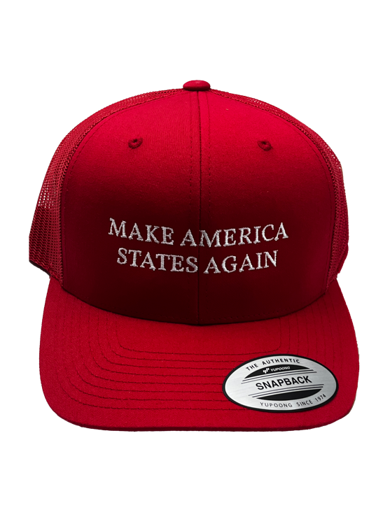
We can make America GREAT again if we insist on making America STATES again!
Notes:
Call to Action
Encouragement: Use existing constitutional mechanisms to enforce federal limits.
Final Quote: “We can make America great again if we insist on making America STATES again!”
“Let’s not call a convention to fix the Constitution, without first insisting that our elected officials follow the Constitution.”

